Slide 1
Welcome to Mrs. Harle’s Grade 2 Classroom!
Before my presentation, you are invited to:
Look outside and try to guess which portrait is your child’s
(lift up the portrait to see if you are correct).
Look around the room at their work.
Take the quiz they made for you.
Write them a letter telling them if you guessed correctly on the portrait and quiz. Tell them what an awesome job they are doing so far.
Class Mom may be collecting party money/emails so look for her.
Visit any Special Area Teachers or PTO Tables in Gymnasium.

Slide 2
Welcome to Mrs. Harle’s Grade 2 Classroom!
After my presentation, you are invited to:
Look outside and try to guess which portrait is your child’s
(lift up the portrait to see if you are correct).
Look around the room at their wor.
Take the quiz they made for you.
Write them a letter telling them if you guessed correctly on the portrait and quiz. Tell them what an awesome job they are doing so far.
Class Mom may be collecting party money/emails so look for her.
Visit any Special Area Teachers or PTO Tables in Gymnasium.

Slide 3
Back to School Night
River Edge Public Schools
Cherry Hill, Roosevelt, and New Bridge Center
Wednesday, September 13, 2023
Mrs. Helen Harle
Grade 2
WELCOME

Slide 4
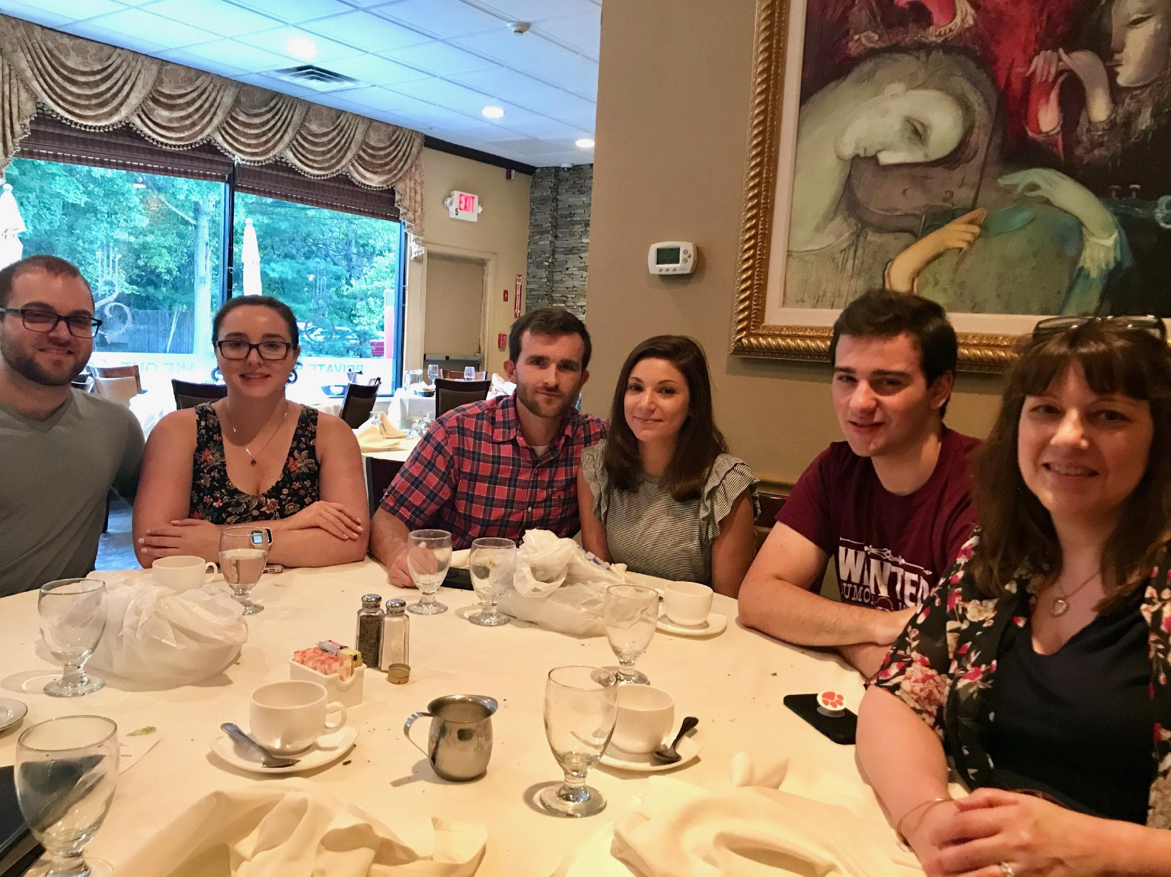
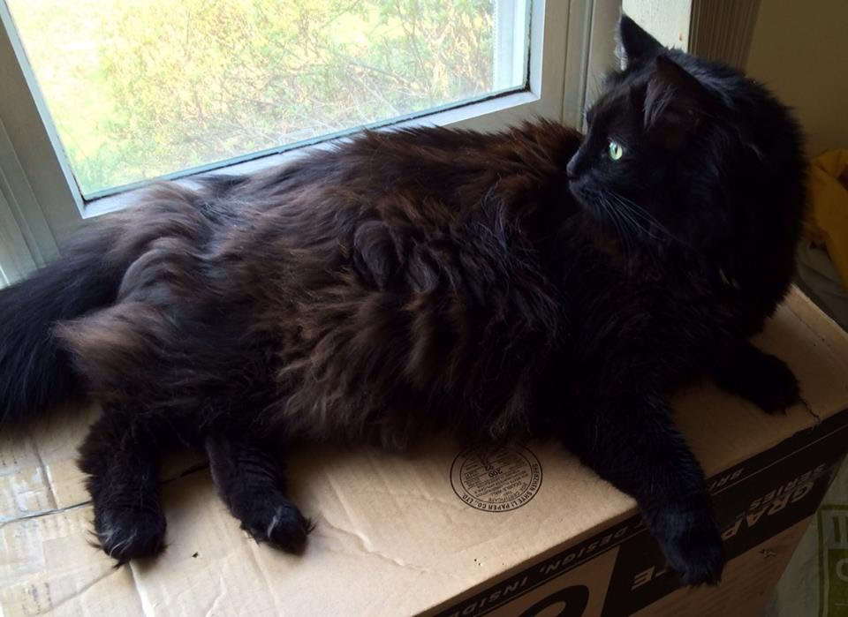
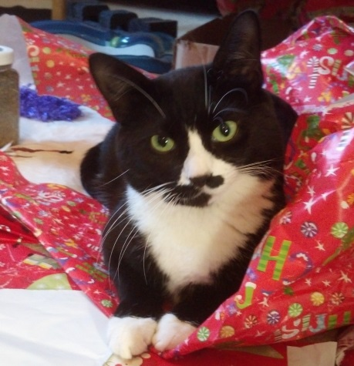
Meet Mrs. Harle
My name is Mrs. Helen Harle. I have been teaching in River Edge since 2004. Before coming to River Edge, I taught Kindergarten and Pre-Kindergarten at private schools. I have my Bachelor's Degree from East Stroudsburg University and my Masters in Education from Montclair State University. I have a son and two daughters. I have two cats: a mother and her daughter that we rescued and raised (along with her 4 siblings that were adopted out). In my spare time I enjoy reading, traveling, attending my son’s sporting and college events, spending time with my family, and taking care of my pets.
My classroom philosophy is to create a safe, nurturing environment where children feel comfortable, willing to take risks, challenge themselves to do their best, and learn to appreciate and respect everyone. We follow the school philosophy of taking care of ourselves, taking care of each other, and taking care of our place.
Notes:
Please include some information about yourself and include a brief icebreaker to begin the session.

Slide 5
General Information
Class Parents: Marissa Bednarski
Contact Parent: Marissa Bednarski
Three class parties with food: Halloween, New Year’s, and End of the Year.
Reader’s Theater in June
Cellphones, SmartWatches, etc, must be turned off and stored in backpacks at all times if brought into school
Notes:
Please include some information about yourself and include a brief icebreaker to begin the session.

Slide 6
General Information
Positive Behavior Management: Star Jar Whole Class Rewards and individual sticker chart for positive behaviors
NJSLS incorporated into all lesson plans: Rigor, complexity of text, higher order questioning in literature and fluency and problem solving in math
Equity, Diversity, and Inclusion: Our vision is a community that is welcoming to all and is a model of acceptance and respect.
EDI resources and activities can be found found at the following link:
https://sites.google.com/riveredgeschools.org/recurriculum/equity-diversity-inclusion/e-d-i-resources?authuser=0
Notes:
Please include some information about yourself and include a brief icebreaker to begin the session.

Slide 7
Social Emotional Learning
Responsive Classroom and Community Time
Each class will begin with Morning Meeting/Afternoon Meeting/Community Time (designed to support students' social and emotional needs) at 8:30 am.
Responsive Classroom - Grades Pre-K - 3
Goals: Positive Community, Effective Management, Developmentally Responsive Teaching, Engaging Activities to Promote Academics
Morning Meeting: Greeting, Sharing, Activity, Message
Energizers: Brain Breaks incorporated throughout the day
:

Slide 8
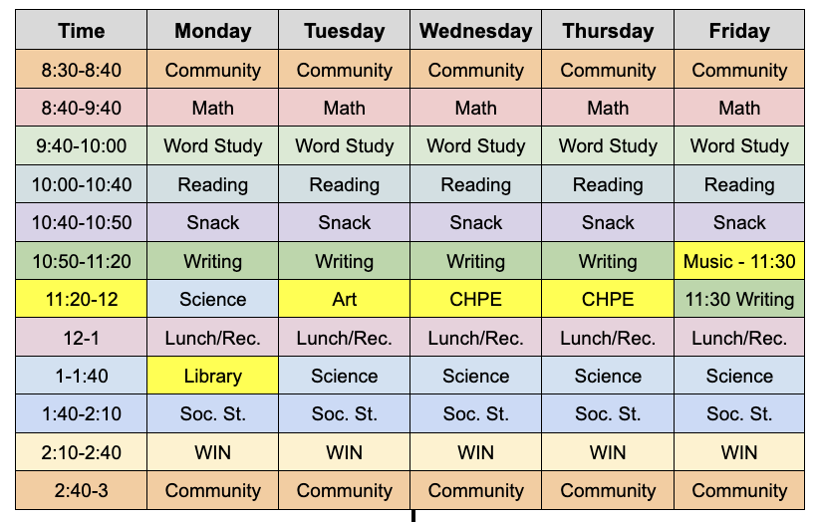
Typical Weekly Schedule for Class
Class schedules are posted in Google Classroom under “Weekly Schedule.”

Slide 9
Related Arts Schedule
Monday: Library - Ms. Ranieri 1:00-1:40
Tuesday: Art - Ms. Del Guidice 11:20-12:00
Wednesday and Thursday: Phys. Ed./Health -
Ms. Naimaister, 11:20-12:00
Friday: Music - Ms. Dent 10:50-11:20
* Any Related Arts questions should be directed to the Related Arts Teacher.

Slide 10
Typical Lesson Structure
Mini Lesson/Activity Introduction ( 10 minutes)
Teacher teaching
Independent Student Work/Practice ( 20 minutes)
Students work independently
Teacher will monitor students offering support as needed
Review of Assignment/Share ( 5 minutes)
Students re-engage
Teacher will facilitate review or sharing of activity/assignment for all students
Lesson Closure ( 5 minutes)
Teacher will wrap-up lesson with closure activity or discussion
Students will have a few moments to stretch and reset for the next class/lesson

Slide 11
Reading - Units of Study
Reading Workshop
Balanced literacy
Just right books
Reading with fluency
Understanding parts of a story
Retelling
Fiction and nonfiction texts
Readers response
Understanding the author’s purpose
Guided reading groups
Notes:
For each of the content slides, as a Grade Level Team, include a general description of what is taught for that content area

Slide 12
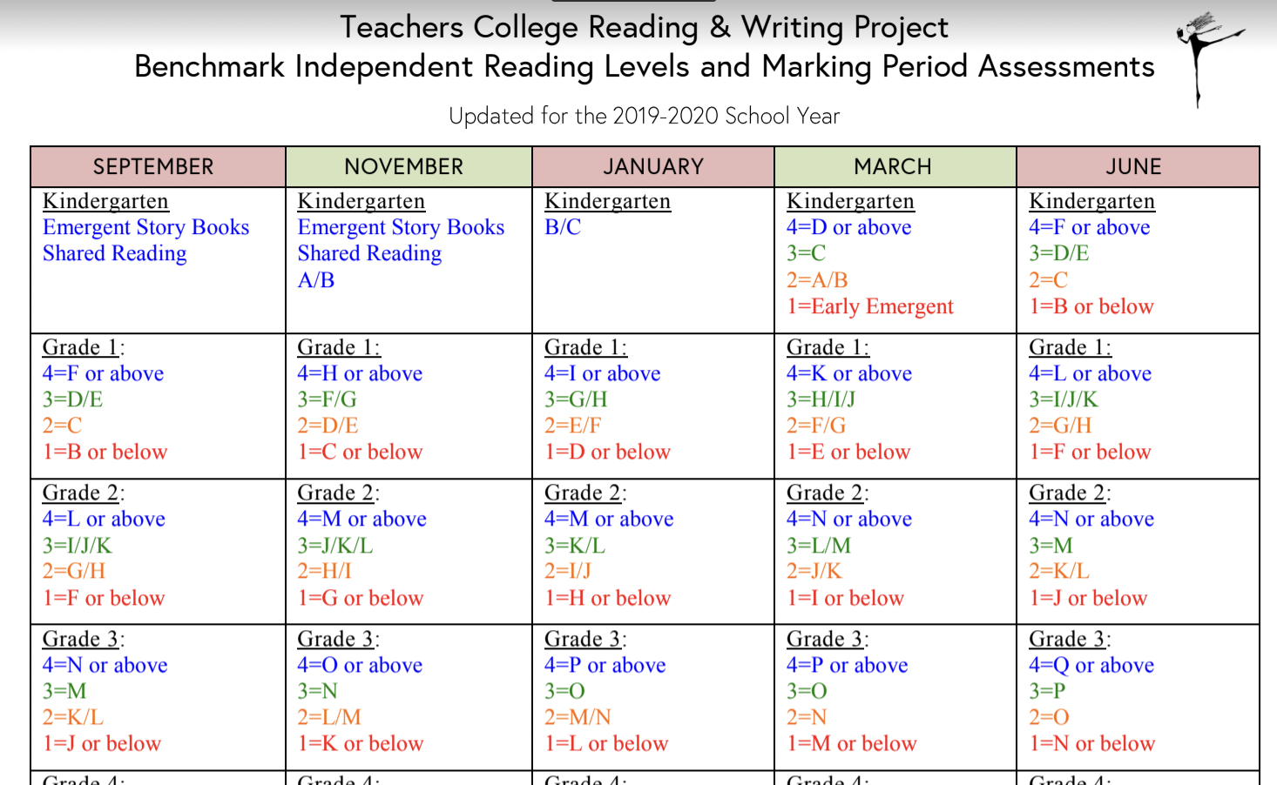

Slide 13
Word Study - Units of Study
Word Study (Phonics, spelling, grammar, vocabulary)
How words are formed
Patterns
Rules
Fundations
Sadlier workbook
G.U.M workbook - Grammar, Usage, and Mechanics
Notes:
For each of the content slides, as a Grade Level Team, include a general description of what is taught for that content area

Slide 14
Writing - Units of Study
Writing Workshop
Sustained writing on one topic
Using grade appropriate grammar
Using developmental spelling
Looking to authors as mentors
Editing/revising his/her work
Including his/her own voice
Being creative

Slide 15
Math - Units of Study
Everyday Math
Online component
Addition and Subtraction facts
2 Digit Addition
2 Digit Subtraction
Counting Coins and Dollars
Making Change
Arrays
Geometry
Word Problems
Manipulatives
Homelinks
Math games
Khan Academy online access

Slide 16
Science - Units of Study
S.T.E.A.M.(science, technology, engineering, arts, math) - in STEAM Lab this year February through June
Science Textbook: National Geographic Program-NGSS aligned
Matter
Processes that shape Earth
Ecosystems

Slide 17
Social Studies - Units of Study
Social Studies
Roles and Responsibilities in Communities
Communities: Economics and Resources
Our World and People
One World: Different Perspectives

Slide 18
Health - Units of Study
Safety Germs
Strangers Eating Healthy
Your Heart Your Brain
Your Skin Your Muscles
Decision-Making
Feelings

Slide 19
How Should Student Work/Assignments
Be Submitted
In Class: Please check the blue Homework folder daily, for work and notes from school. Return any homework in the folder. Math Home Link Books will go home daily, and need to be returned, daily. We will review math homework together in class.
IF Virtual: Every child will get a red or orange folder and already have a blue Homework folder.
These two folders will be used to send work to and from school. You will always have one and I will always have the other. Packets will come home every week
On pickup days, you would need to send back all work your child has completed and I will send new work home.
Notes:
Please include how work/assignments (hard copy and digital) should be submitted

Slide 20
Student Health/Safety Expectations
Wear masks or not as directed by parents or state
Follow school rules, including all security drills
If not feeling well, tell an adult
Wash hands with soap and water for at least 20 seconds
Snack is included in the schedule. Students are not permitted to share food.
Follow signs in the hallways and bathroom at all times

Slide 21
Support and Assessment
Small group work and one-on one-support can and will be provided at back table.
Assessments will be given on paper and on computers
Reading and Writing Conferences will continue to inform instruction
New Jersey Student Learning Standards (NJSLS) and District Benchmarks will continuously be assessed
DIBELS Benchmark Assessment: Given at the beginning, middle, and end of the year to students in Grades K-3 to identify students who may be at risk of reading difficulties and progress monitor students’ reading skills

Slide 22
W.I.N.-What I Need Intervention Period
Tier 1 - Universal Supports & Enrichment - These students either receive reinforcement from the classroom teacher or enrichment from an Enrichment teacher during their W.I.N. Period because they are either meeting or exceeding grade-level expectations in a certain skill area.
Tier 2 - Targeted, Small Group Interventions - These students receive support from either an Interventionist or Classroom Teacher during their W.I.N. Period. These students usually need a little more support in a certain skill to ensure they reach grade-level benchmarks by the end of the school year.
Tier 3 - Intensive Interventions - These students receive support from either an Interventionist or Special Education Teacher during their W.I.N. Period. These students need more support in one or more skills areas to ensure they reach grade-level benchmarks by the end of the school year.
https://sites.google.com/riveredgeschools.org/win/home
Notes:
Please include some information about yourself and include a brief icebreaker to begin the session.

Slide 23
Post Dismissal Instructional Academy - PDIA Grades 2-6
Weekly, after-school, instruction for students in Grades 2-6
This service is offered only to students who we feel need to close some learning gaps in either Math or English Language Arts
This year no Social Emotional PDIA will be offered to K-6 students that qualify
Selection criteria of students who qualify for this service, is based on multiple factors, including teacher recommendation and benchmark assessment results
Eight week cycles of instruction in specific skills for Math and English Language Arts
Classes are one hour long and run from 3:15 to 4:15 one day a week
Classes are taught by classroom teachers, who are familiar with the material for the grade level

Slide 24
Gifted and Talented
Gifted & Talented
New program this year → Tiered Support Model
Tier I - Universal Support (i.e.. Clubs, STEAM, Extracurriculars, POP, Competitions, etc)
Tier II - Targeted Support (i.e. Academic Enrichment - both pull out and push-in targeted academic support for identified students)
Tier III - Intensive Support (i.e. REignite - pull out Gifted learning classes for identified students)
Students who qualify for Tier II or Tier III will receive identification letters by early October via the Genesis Parent Portal
Please visit our table in the Gym to learn more about our new Gifted & Talented program

Slide 25
Report Cards
Report Cards
Report Cards will be issued three times during the school year with Parent-Teacher Conference times offered to discuss student progress
The River Edge Public School District will continue to implement standards-based report cards for grades K-6 this school year..
There will be no traditional letter grades on your child’s report card (ONLY Grades 5 and 6 will receive letter grades)
Report cards will reflect progress that your child is making on specific skills selected from the New Jersey Student Learning Standards in each content area
Progress will be evaluated as the following:
4 - Exceeds Grade Level Standards
3 - Securely Meets Grade Level Standards
2 - Approaching Grade Level Standards
1 - Needs Support
N - Not yet introduced/Not yet assessed

Slide 26
Student AUP and Behavioral Expectations
Students will be held to the Acceptable Use Policy they agreed to follow
Technology must be used with responsibility and respect
Loss of technological privileges and tools will be enforced if necessary

Slide 27
Student Supplies and Materials
Students may share supplies and/or materials
Student supplies, materials, and belongings will be kept in backpack, classroom, cubbies, and in their desk
Personal hand sanitizer (unscented) is recommended for each child

Slide 28
Take Care of Yourself,
Take Care of Eachother,
Take Care of This Place.
Margaret J. Wheatley
As We Embark On This Yet Again Unprecedented Year, Let Us Remember:
We Are In This Together
We Are River Edge Strong
We Are Partners in Helping Our Students Learn, Grow, and Thrive During This Uncertain Time
As With All Change, Problems and Challenges Will Arise, BUT Patience, Perseverance, and Positivity Will Lead to New and Surprising Possibilities

Slide 29
Contact Information
Email: harleh@riveredgeschools.org
Class Website: Mrs. Harle's Second Grade Class
Google Classroom Code: hbe32fl
Best Way/Time to Contact: Class Dojo, before and after school 8:25-3:00. Urgent messages should be called in to the office and they will relay the message.
Notes:
Input your specific information

